Slide 1
Test plan discussion
Dimmer

Slide 2
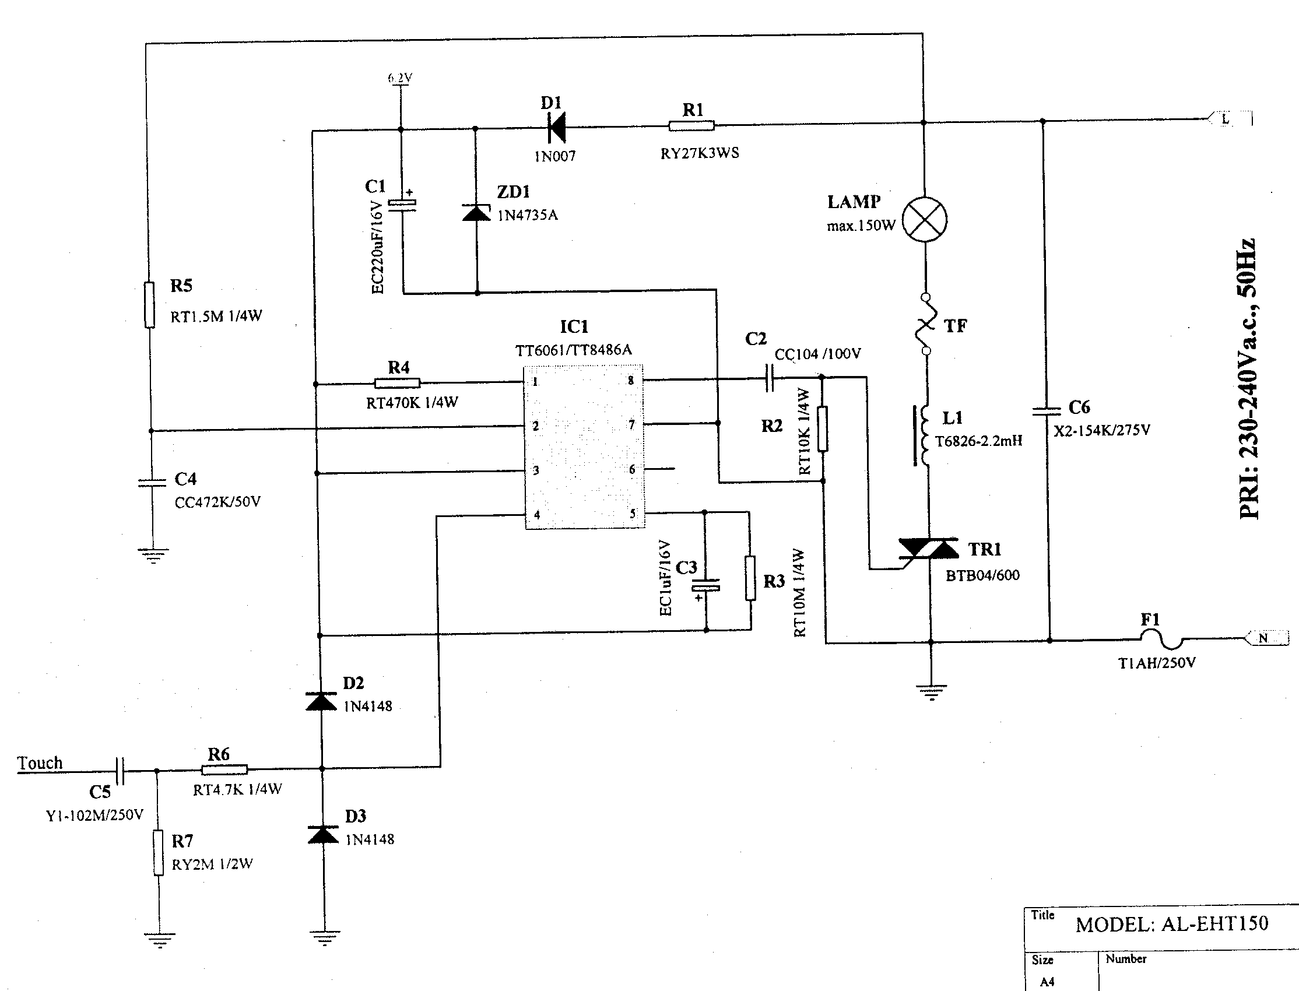
Circuit Diagram

Slide 3
Disturbance Source
IC
TRIAC
Sensitive components for immunity test
IC
TRIAC

Slide 4
Applicable standards
Light standard
EN 55015 :2000+A1+A2 (EMI)
EN 61547 :1995+A1 (EMS)
EN 61000-3-2 :2000 (Harmonics)
EN 61000-3-3 1995+A1 (Flicker)

Slide 5
Test items/operation modes
Disturbance voltage
  AC Mains
  Output port (Depend on the installing instructions)
No Click test

Slide 6
Test items/operation modes
Harmonics
  Adjust to find the maximum disturbance
No test on Flicker
ESD
  According to the sensitive component, TRIAC should be adjust to 30%, 60%, 90% luminous intensity
EFT
  Same as ESD
CS
  Same as ESD
Surge
  Same as ESD
Dips
  Same as ESD

